Slide 1
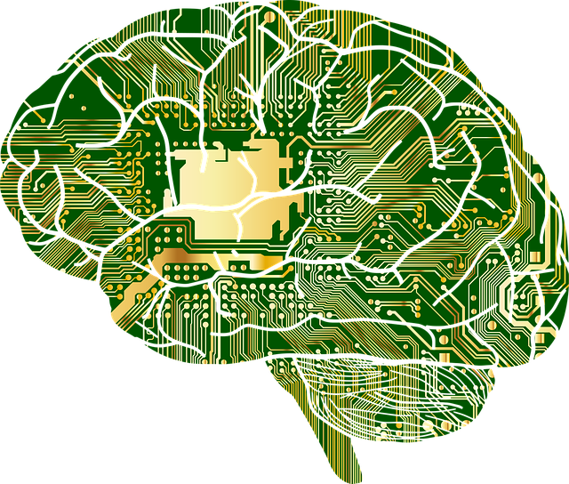
Deep learning
Introduction
Caspar van Leeuwen, David Ruhe

Slide 2
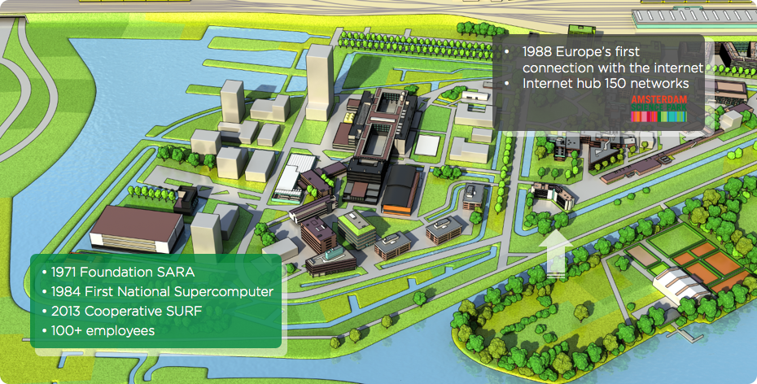
SURFsara
Notes:
SARA stands for Stichting Academisch Rekencentrum Amsterdam
Originally meant as a compute and data storage facility for VU, UvA and CWI
SURFsara part of SURF (SURFnet - networking and SURFmarket - ‘inkoop’ (software, digital content))
Universities, UMCs and many other higher education institutes have access to our facilities

Slide 3




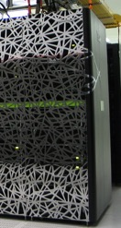
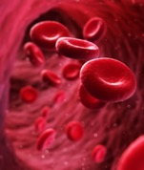

SURF
Notes:
Distinction between High Performance Computing - mainly supercomputing, also cluster & HPC Cloud
Data processing on grid, HPC Cloud and other facilities
Data services for mass storage, archiving and data management
We are part of the data analytics team, focusing on Big Data technologies, and machine learning

Slide 4
SURFsara
High performance computing | Data processing | Data services
Supercomputing | Data analytics | Mass online storage
Clustercomputing | Grid services | PID service
Machine learning | Visualization | Data management
HPC cloud | HPC cloud | Data preservation
Notes:
Distinction between High Performance Computing - mainly supercomputing, also cluster & HPC Cloud
Data processing on grid, HPC Cloud and other facilities
Data services for mass storage, archiving and data management
We are part of the data analytics team, focusing on Big Data technologies, and machine learning

Slide 5


Who are we?
Caspar van Leeuwen
Advisor Cluster/Supercomputing
Support users in using Cartesius / Lisa
Strong interest in Deep Learning
Other activities, e.g. Training
David Ruhe
Advisor Machine Learning
Support ML workloads on HPC infrastructure
Other activities, e.g. joint (ML) research projects
Notes:
Distinction between High Performance Computing - mainly supercomputing, also cluster & HPC Cloud
Data processing on grid, HPC Cloud and other facilities
Data services for mass storage, archiving and data management
We are part of the data analytics team, focusing on Big Data technologies, and machine learning

Slide 6
Course information
The course will be “hands-on".
We will use R, the programming language.
Disclaimer: R is not a common HPC language, but was thought to fit best with your backgrounds. We are sure we can manage, but are not fluent in R syntax!
We will use Keras, a popular deep learning framework.
Online Jupyter notebook environment - later today
Syllabus, announcements & discussion board @ Canvas
Notes:
It's a complex subject, we will build up knowledge slowly
At the end of the course, you will be able to create deep learning models yourself to solve various problems

Slide 7
Your backgrounds
Any experience in
Programming
R
Statistics
Machine learning

Slide 8
Course plan
Introduction and ML & DL fundamentals
Optimisation & network training
ML tasks (regression vs classification) & regularisation
Sequential data analysis with recurrent neural networks
Image processing with convolutional neural networks
Unsupervised learning
Complex architectures and models
Day 1
Day 2
Day 3
Notes:
Today: comparison of DL and ML, neural network components, a neural network from scratch
Classification and regression introduced in weeks 1 - 3, not as a separate subject
Recurrent neural networks have a ‘memory’ and can take into account long-term dependencies
With unsupervised learning we have no labeled data - clustering, dimensionality reduction
Course plan also in Canvas

Slide 9
Today’s program
14:00-14:30 What is ML / DL? What is a neuron?
14:30-15:30 Hands on: building a neuron from scratch
15:30-15:45 How do neural networks work?
15:45-16:15 Break
16:15-16:30 How do neural networks work? (continued)
16:30-17:15 Hands on: building a network from scratch
17:15-18:00 Loss function & updating weights
18:00-19:00 Diner
19:00-19:45 Hands on: the XOR problem
19:45-20:00 Dataset splitting & Performance evaluation
20:00-21:00 Hands on: Keras on fashion Mnist
If we finish early: Machine learning tasks (classification vs regression)

Slide 10

Overview
Today we will cover
Where deep learning has made an impact.
The basic components of a neural network.
Build a basic neural network from scratch
Perform binary classification using a neural network
Get to know the online Jupyter notebook environment.

Slide 11
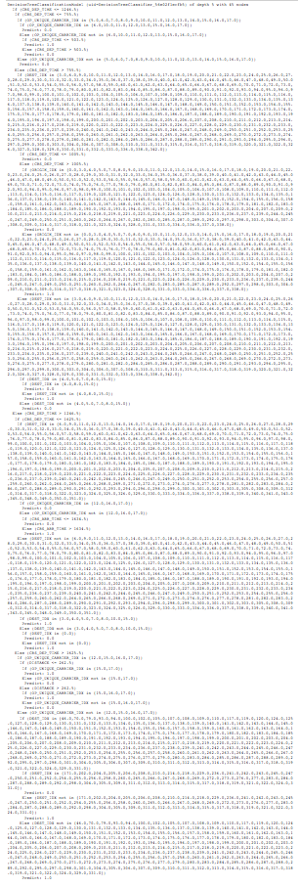
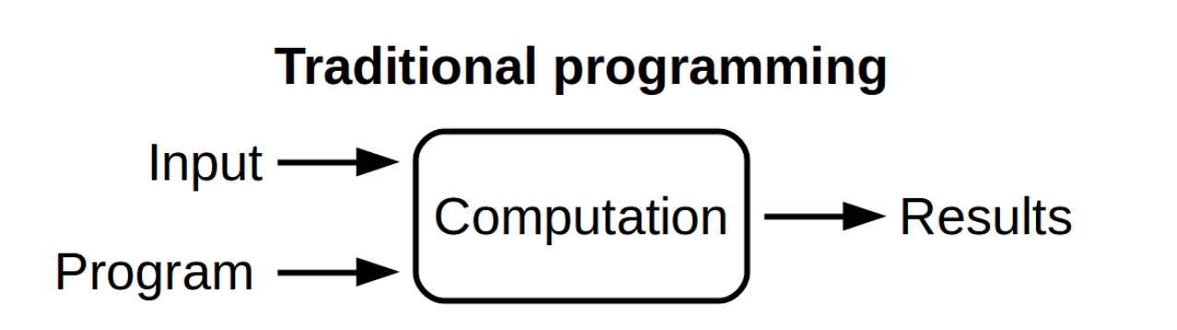
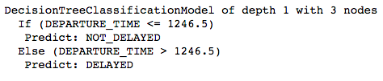
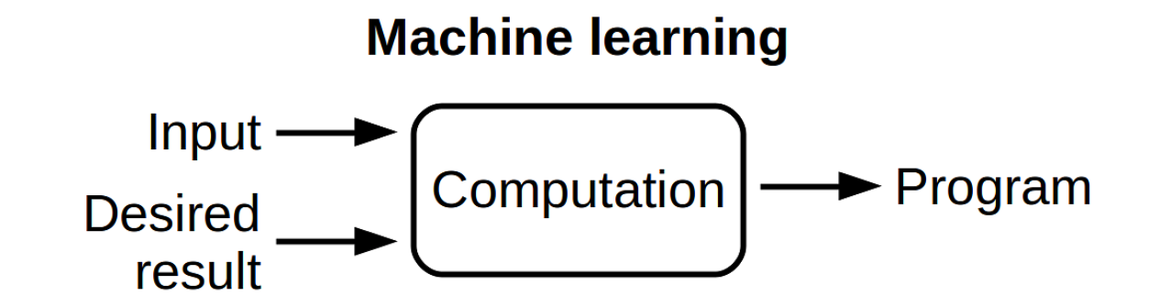
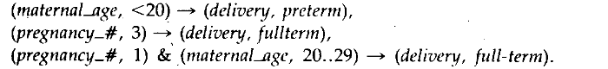
Machine learning
Knowledge base & rules
Expert systems
Human input
Features and result
‘Decision’ system
Limited human input
Source: Machine Learning for an Expert System to Predict Preterm Birth Risk , Woolery et al. (1994)
Notes:
Expert systems encode thought process and decisions of experts:
Apply inference engine to knowledge base to deduce facts and make decision
Machine learning takes input features and the desired results
Human input more limited: model built according to the input data
Based on statistics, but weaker mathematical theory, more engineering-oriented
ML usually less interpretable than expert systems, but more flexible

Slide 12
Machine learning
Learning tasks are often broken into two broad categories, supervised or unsupervised.
In supervised learning we train using the expected output.
Regression
Classification.
In unsupervised learning the expected output is not provided (or does not exist) during training. Instead we rely on the similarity of data points.
Clustering
Dimensionality reduction
Machine learning has many good models but most require some manual work (feature engineering) to perform.

Slide 13
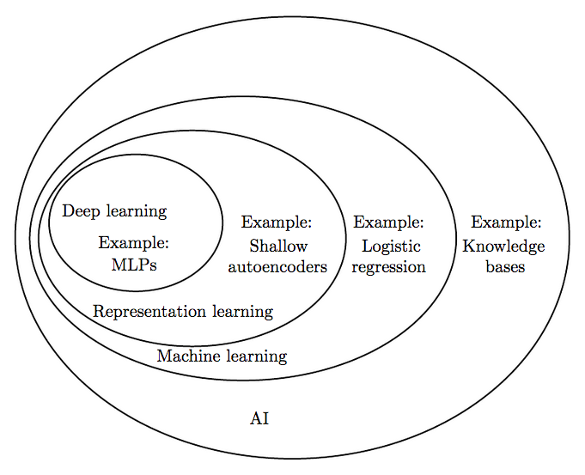
Source: Deep Learning, Ian Goodfellow and Yoshua Bengio and Aaron Courville

Slide 14
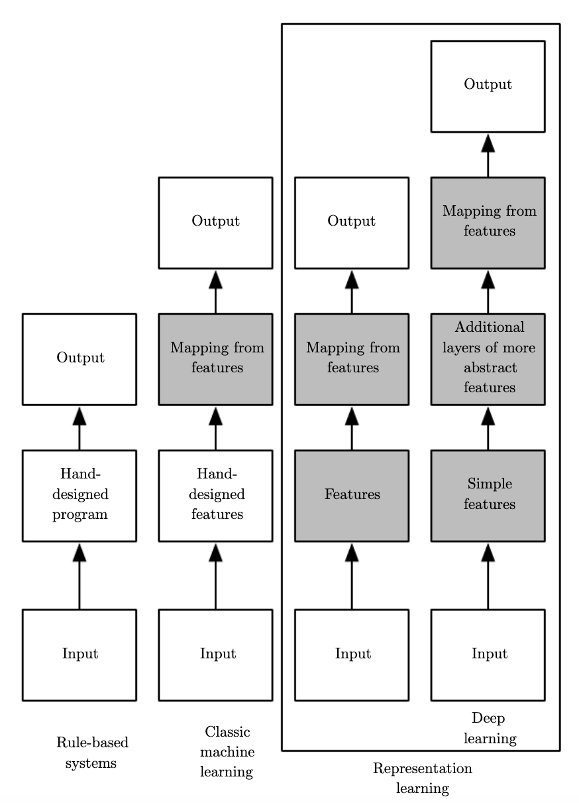
Source: Deep Learning, Ian Goodfellow and Yoshua Bengio and Aaron Courville
Notes:
In grey: components that are able to learn from data

Slide 15
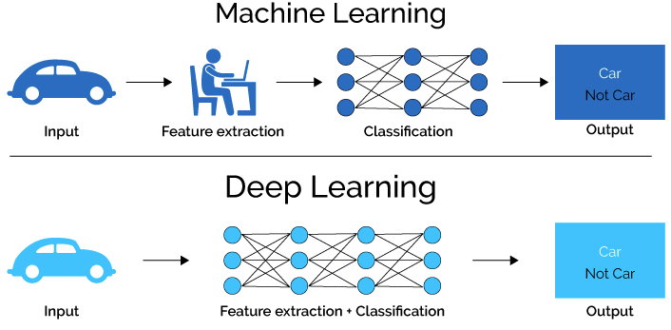
What is deep learning?
Source: Alex, D., 2017: Difference between Machine Learning and Deep Learning.
Notes:
All modelling is done using neural networks which have many layers.
The models learn to represent the data, with less/no feature engineering.

Slide 16
Success of deep learning
Machine translation
Speech recognition
Language recognition based on characters
Image classification
Image screen caption generation
Recommender systems
Drug design
...

Slide 17
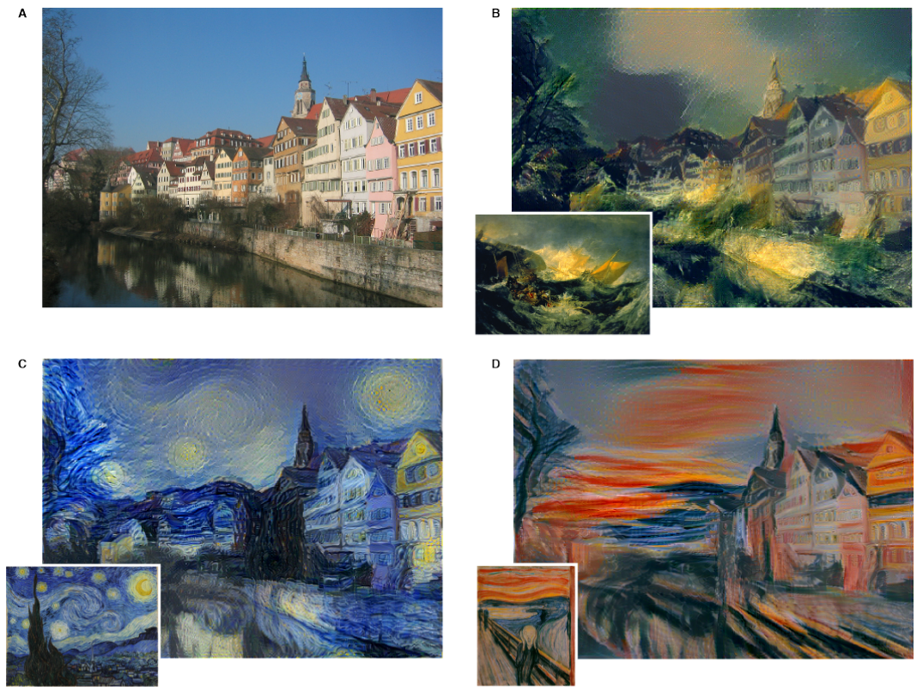
Success of deep learning
Style transfer Source: https://ai.googleblog.com/2016/10/supercharging-style-transfer.html
Notes:
A: original picture of a German town
B: Style of the Shipwreck of the Minotaur (Turner) applied to the picture
C: Starry Night (Van Gogh)
D: The Scream (Munch)

Slide 18
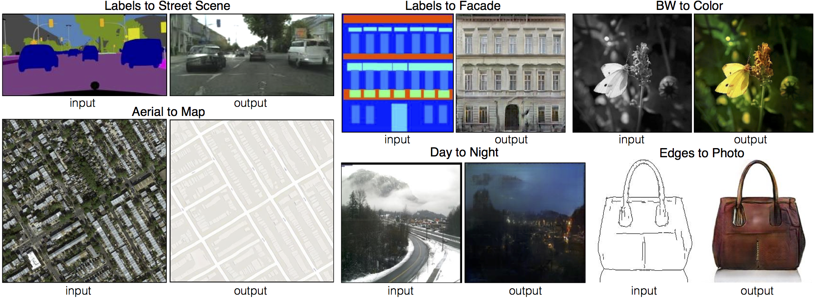
Success of deep learning
Image to image Source: https://phillipi.github.io/pix2pix/
Notes:
Paint street scene based on labels
Deduce street map from satellite image
Colour in B/W pictures

Slide 19
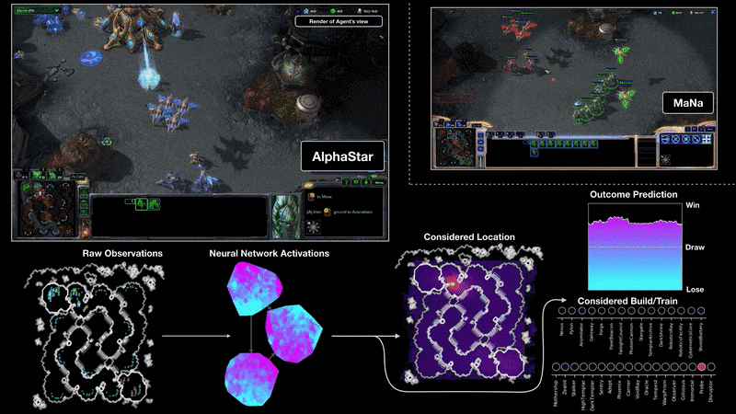
Success of deep learning
Deep reinforcement learning Source: https://deepmind.com/blog/alphastar-mastering-real-time-strategy-game-starcraft-ii/#gif-264
Notes:
Long-term planning, imperfect information, real-time, large action space, no single best strategy

Slide 20

Success of deep learning

Slide 21

Deep learning
Deep learning is based on neural networks

Slide 22
What is a neural network?
Layer 1
Layer 2
Neuron
Neuron
Edges
Neuron
Notes:
Pictured is a feed-forward network
Data travels from left (the input) to right (the output) through the network
We will discuss a single instance ‘travelling’ through the network
Each neuron applies a calculation to its inputs and sends the data onwards
We don’t typically deal with neurons directly, but rather the calculations of the neurons themselves

Slide 23
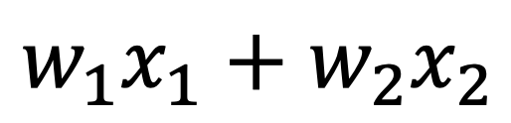


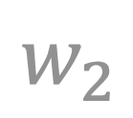
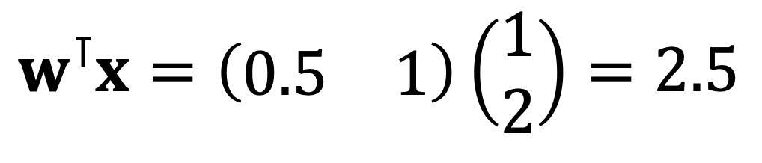

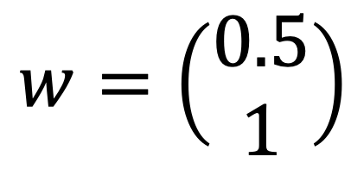

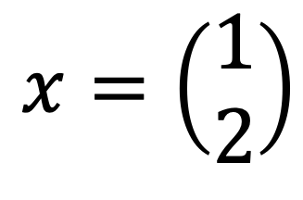
A single neuron
$$w_{1}$$
$$\overset{m}{\underset{i=1}{∑}}w_{i}x_{i}$$
$$x_{1}$$
$$w_{1}x_{1}+w_{2}x_{2}$$
Weights
$$w_{2}$$
$$x=\left(\begin{aligned}1 \\ 2\end{aligned}\right)$$
$$w=\left(\begin{aligned}0.5 \\ 1\end{aligned}\right)$$
$$x_{2}$$
$$w^{⊺}x=\left(\begin{matrix}0.5 & 1\end{matrix}\right)\left(\begin{aligned}1 \\ 2\end{aligned}\right)=2.5$$
Notes:
A single dense neuron with two inputs, x1 and x2
Each input has a weight associated with it: w1 for x1, w2 for x2
The neuron simply multiplies the weights by their inputs, and sums the result
Denoting the inputs as a column vector x, and the weights a column vector w, this equation is equal to the transpose of w times x
There is no single notation used for neural networks, this one makes sense for processing a single instance. In the notebooks we will use a slightly different formulation because we will process an entire data set at once.

Slide 24
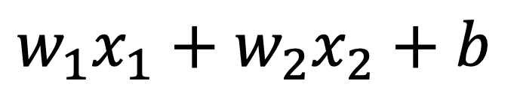

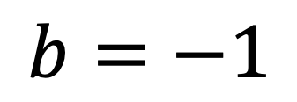

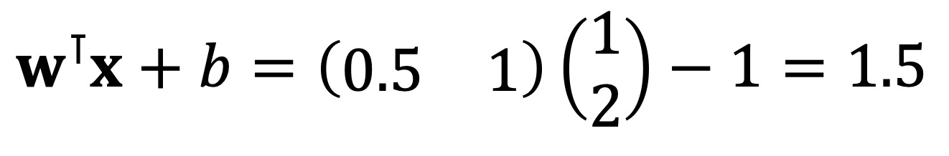
A single neuron
$$w_{1}$$
$$\overset{m}{\underset{i=1}{∑}}w_{i}x_{i}+b$$
$$x_{1}$$
$$w_{1}x_{1}+w_{2}x_{2}+b$$
Weights
$$b=−1$$
$$w_{2}$$
$$x_{2}$$
$$b$$
$$w^{⊺}x+b=\left(\begin{matrix}0.5 & 1\end{matrix}\right)\left(\begin{aligned}1 \\ 2\end{aligned}\right)−1=1.5$$
Notes:
Each neuron also has a single bias term. Think of it as an intercept, that can shift the output by a certain amount. We will explore its usefulness in the notebook later.

Slide 25


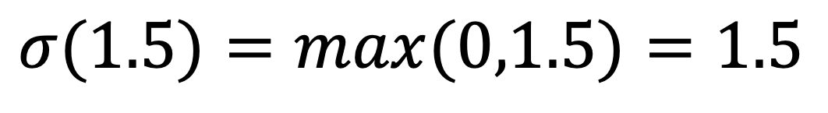
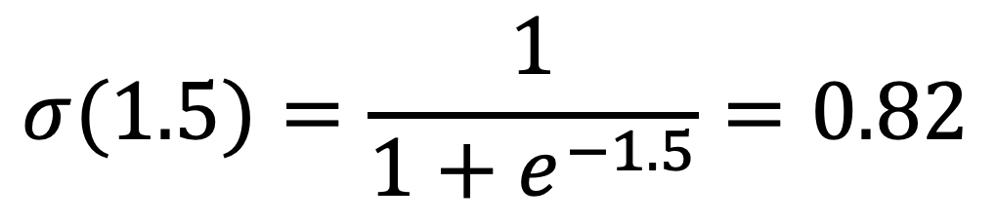
A single neuron
$$w_{1}$$
$$σ(\overset{m}{\underset{i=1}{∑}}w_{i}x_{i}+b)$$
$$x_{1}$$
Weights
$$σ(1.5)=\frac{1}{1+e^{−1.5}}=0.82$$
$$σ(1.5)=max(0,1.5)=1.5$$
$$w_{2}$$
$$x_{2}$$
$$b$$
Source: Activation Functions in Neural Networks
Notes:
Activation functions introduce non-linearity, which is crucial for solving almost any kind of problem
Sigmoid and ReLU (rectified linear unit) are well-known

Slide 26



Prediction
$$w_{1}$$
$$\overset{m}{\underset{i=1}{∑}}w_{i}x_{i}+b$$
$$x_{1}$$
$$\hat{y}$$
$$w_{2}$$
$$x_{2}$$
$$b$$
inputs
weights
summation + bias
activation
output
Notes:
Going from left to right, from inputs to the output, we make a prediction called ˆy (‘y hat’)

Slide 27
Before we begin
Refresh some R
Tensor manipulation
Implement a neuron from scratch

Slide 28
Hands-on
Exercises in Jupyter notebooks
Notebooks run on Lisa, the national compute cluster
Lisa has approximately 300 nodes, 4800 cores
During course hours: 16 full nodes reserved
Outside course hours: 1 node / capacity for 8 notebooks
First users of Jupyter @ Lisa!

Slide 29
Hands-on
Notebook session will start when you login (may take up to a minute or so).
Closing the browser does not shut down the notebook session.
To manually start / shut down a notebook session:
‘Home’ (top left) => Start / Stop My Server.
Please shut down sessions when working outside of course hours, since capacity is limited!

Slide 30
Hands-on
First time: login & change password @ https://portal.surfsara.nl
Go to https://https://jupyter.lisa.surfsara.nl:8000/
Notebook: 01a-neuron-from-scratch.ipynb
14:30-15:30

Slide 31
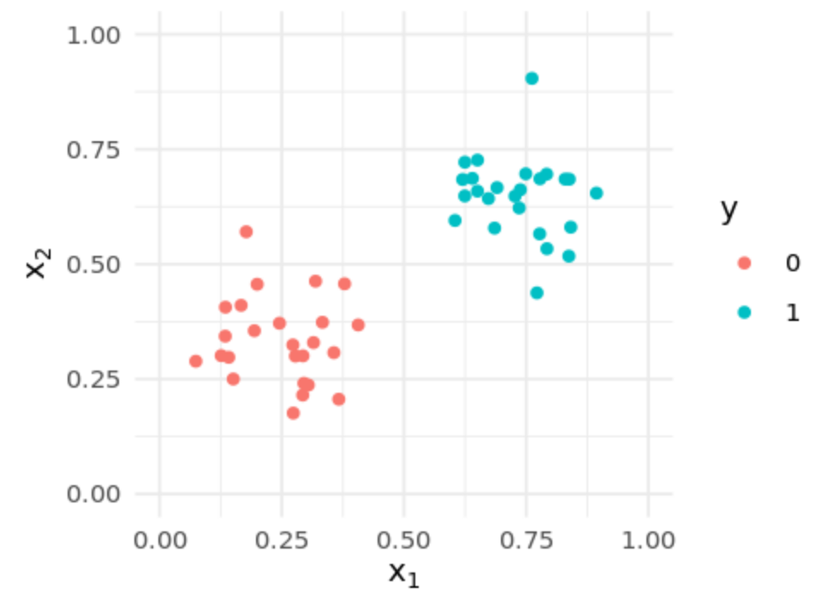

Notebook recap
Data preparation / restructuring is necessary
Weights change the ‘slope’
Bias shifts decision boundary
$$b$$
Notes:
Some data wrangling is always necessary when working with neural networks and deep learning
Slicing and dicing, proper dimensionality and shape of your data is extremely important
Keras (R deep learning package in next session) can do a lot for us, but not everything
Weights change the ‘slope’ of a decision boundary, bias shifts it. Both are essential for neural networks.

Slide 32
Today’s program
14:00-14:30 What is ML / DL? What is a neuron?
14:30-15:30 Hands on: building a neuron from scratch
15:30-15:45 How do neural networks work?
15:45-16:15 Break
16:15-16:30 How do neural networks work? (continued)
16:30-17:15 Hands on: building a network from scratch
17:15-18:00 Loss function & updating weights
18:00-19:00 Diner
19:00-19:45 Hands on: the XOR problem
19:45-20:00 Dataset splitting & Performance evaluation
20:00-21:00 Hands on: Keras on fashion Mnist
If we finish early: Machine learning tasks (classification vs regression)

Slide 33
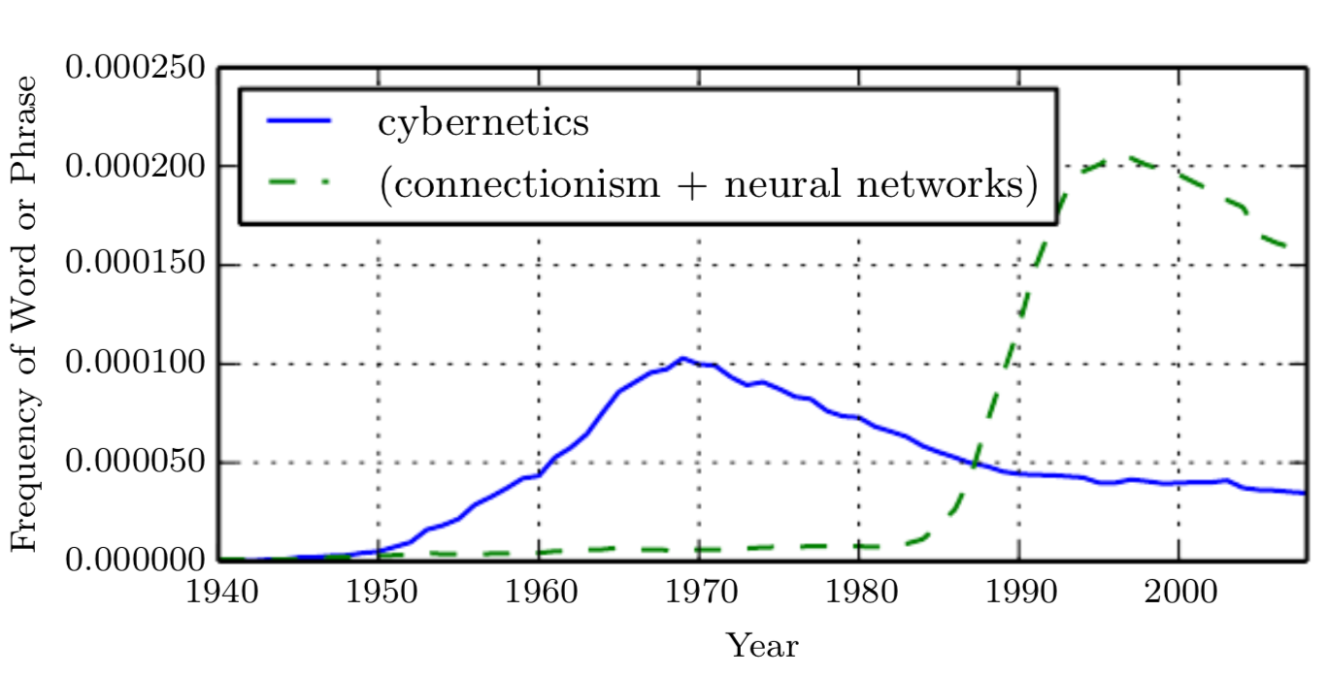
Why the success?
No single reason, much of the theory is old
Source: Andrew Ng, Deep learning course
Notes:
First description of an artificial neuron in 1943 (McCulloch-Pitts neuron) - cybernetics
Training a neuron in ~1960
NNs could not solve non-linear problems at the time; led to a loss in popularity
1980s: second wave - connectionism, neural networks
Eclipsed by other machine learning advances (SVMs, ensemble methods)
Failure of a mini-hype in AI in the mid 90s
Third wave from 2006 onwards
Waves of interest in neural networks:

Slide 34
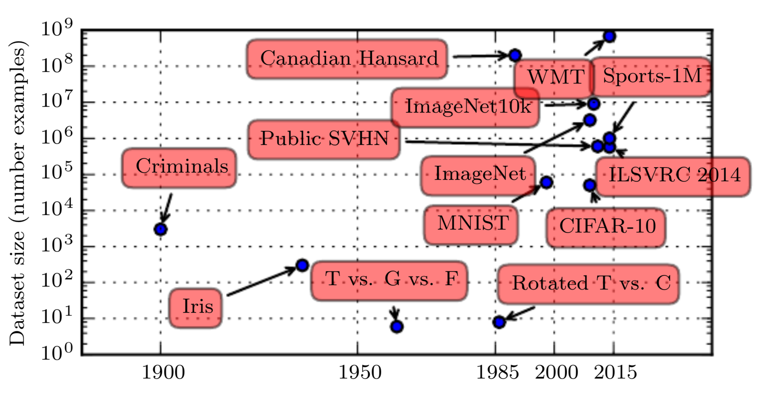
Why the success?
More data available
Source: Deep Learning, Ian Goodfellow and Yoshua Bengio and Aaron Courville
Notes:
Vastly more data available
Digitisation of society makes collecting larger datasets easier
Exceed human performance with 10 million examples or more
WMT: ~ billion samples for machine translation

Slide 35
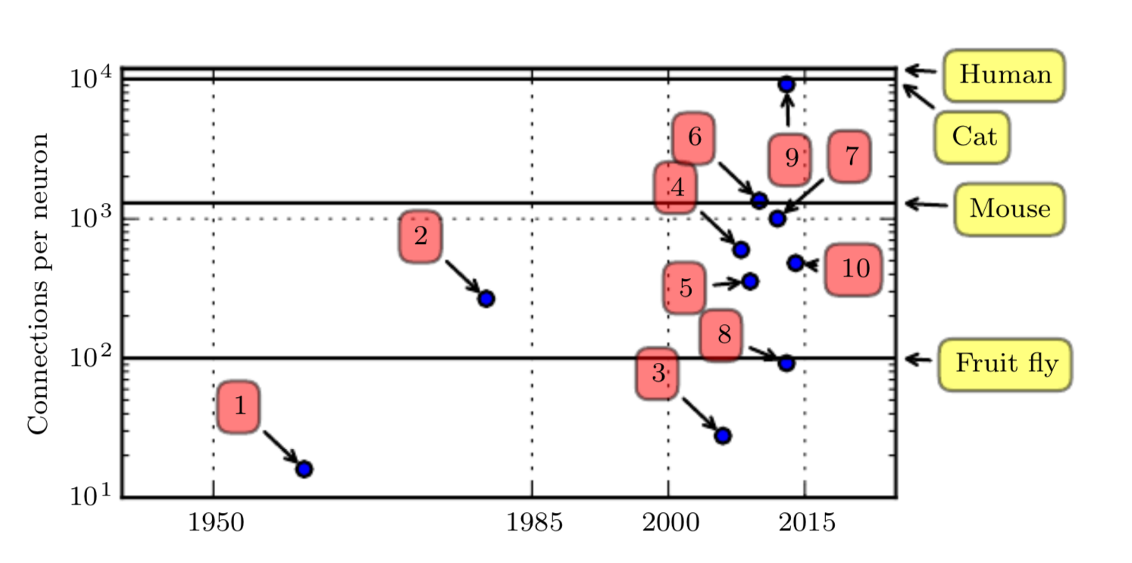
Why the success?
Bigger models
Source: Deep Learning, Ian Goodfellow and Yoshua Bengio and Aaron Courville
Notes:
ADALINE and Neocognitron at (1) and (2), resp.
Most larger models have more connections than a mouse’s brain
Approaching cat level of number of connections

Slide 36
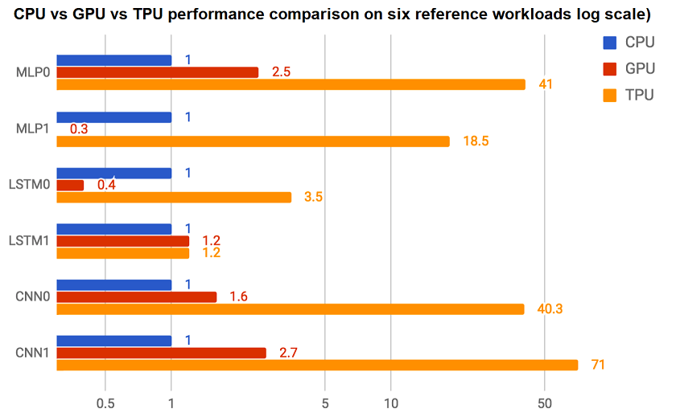
Why the success?
More compute power
Source: https://www.androidauthority.com/google-powering-ai-816146/
Notes:
CPU is the central processing unit of a machine - flexible, but not optimized for massively parallel linear algebra operations needed for deep learning
GPUs (graphics processor units) excel in parallelisation of matrix operations like multiplication and addition
TPUs (tensor processing units) are specialised hardware units for deep learning purposes from Google, available from the Google cloud
Not just compute power, also more powerful methods (e.g. ReLU)

Slide 37
How do NNs work?
We want to make a model to predict housing prices
# beds
Family size
Size
Walkability
Price
Zip code
School quality
Wealth
Notes:
We can build an expert system that combines features hierarchically into a single housing price
We are doing the work, this is not machine learning

Slide 38
Hidden layers
Or just hit it with a hammer and let the model learn the features
# beds
?
Size
?
Price
Zip code
?
Wealth
Notes:
Neural networks can learn the relevant features themselves
No feature engineering: learn from data
Training such a model is left for the next session
The network we implemented is just a single neuron: no hidden layers

Slide 39
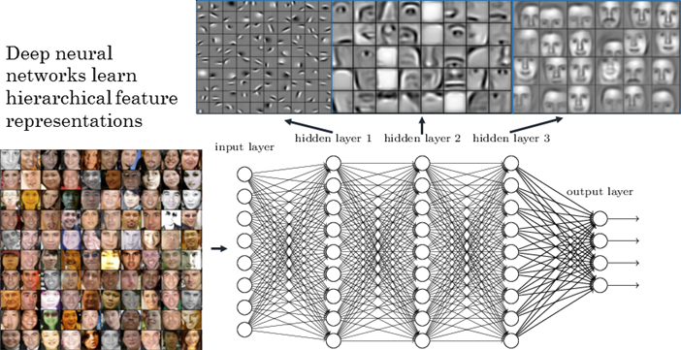
How does it work?
Layers
Source: A Comprehensive Hands-on Guide to Transfer Learning with Real-World Applications in Deep Learning
Notes:
When piling layers on top of layers, the network learns to compose complex concepts from simpler (lower in hierarchy) concepts.
For example, a face might be composed of a an ear, eyes, etc.
(If successful) the network learns to filter-out irrelevant information (lighting, angle, noise) when building the representation.

Slide 40
Hidden layers
We can easily create more layers
Interpretability may become more difficult
Universal approximation theorem
"Given a neural network with a single hidden layer of sufficient size, the network can model can approximate any function in ℝ^{p} ”
In other words:
There is a ‘true’ function f relating the inputs X to outputs Y
NN can approximate this function to arbitrary precision given sufficient layer size
Required layer size can be extremely large and grow rapidly (e.g. exponential) with the dimensionality of the problem (p)
# beds
?
?
Size
?
Price
Zip code
?
?
Wealth
Notes:
By adding more layers we create a ‘deep’ network
Universal approximation: the size of the hidden layer needs to be ‘arbitrarily large’, often exponential in size, and learnability is difficult

Slide 41
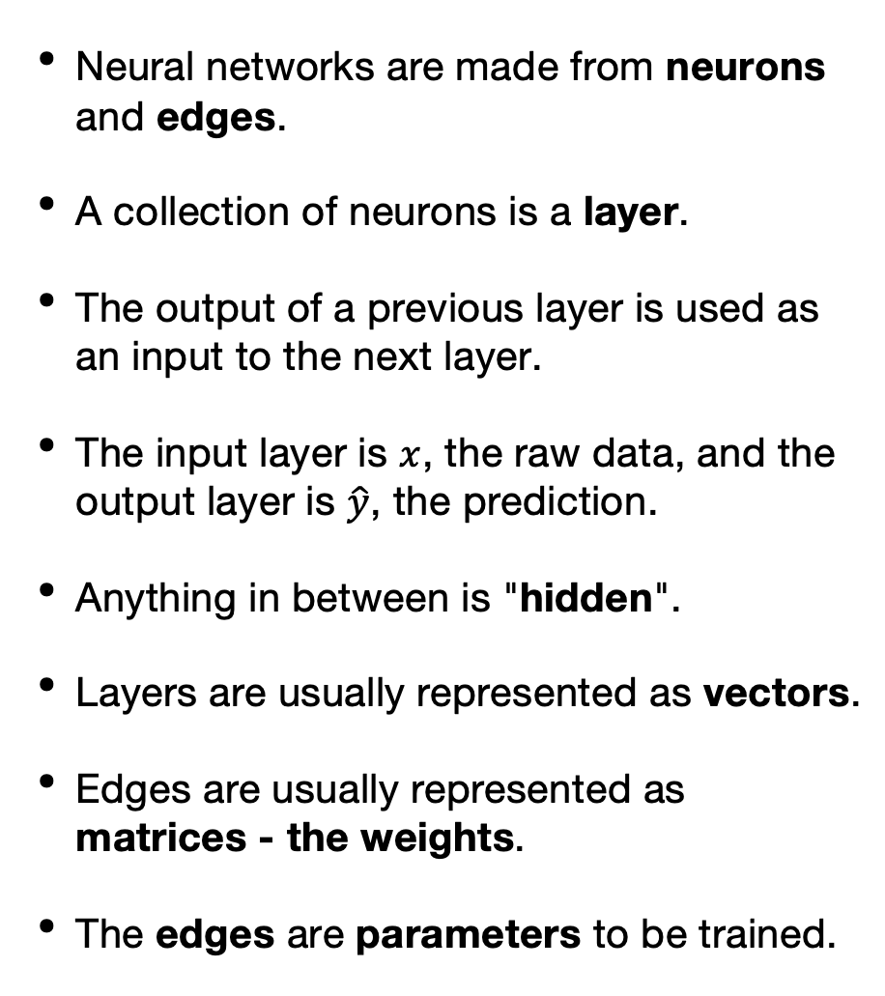
The components
Neural networks are made from neurons and edges.
A collection of neurons is a layer.
The output of a previous layer is used as an input to the next layer.
The input layer is $x$, the raw data, and the output layer is $\hat{y}$, the prediction.
Anything in between is "hidden".
Layers are usually represented as vectors.
Edges are usually represented as matrices - the weights.
The edges are parameters to be trained.
Notes:
Each neuron takes inputs and applies a non-linear function to it
Neurons are grouped into layers
Layer outputs are fed forward through the network
Edges are usually called weights

Slide 42
The components
There are many types of layers, the previous example is a dense layer: all neurons in one layer are connected to all neurons in the next layer.
Piling many dense layers, creates a Multi Layer Perceptron (MLP) and is very powerful, but expensive.

Slide 43
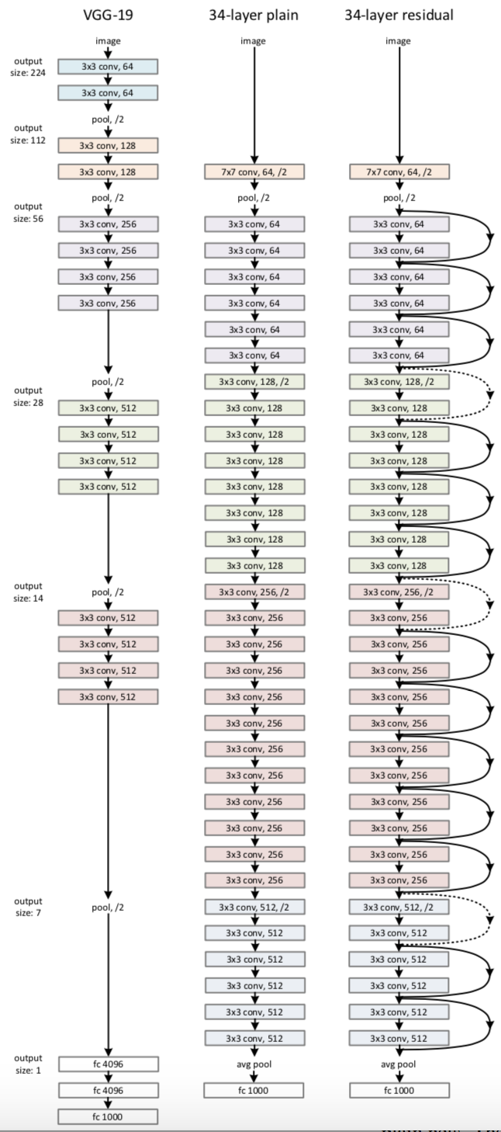
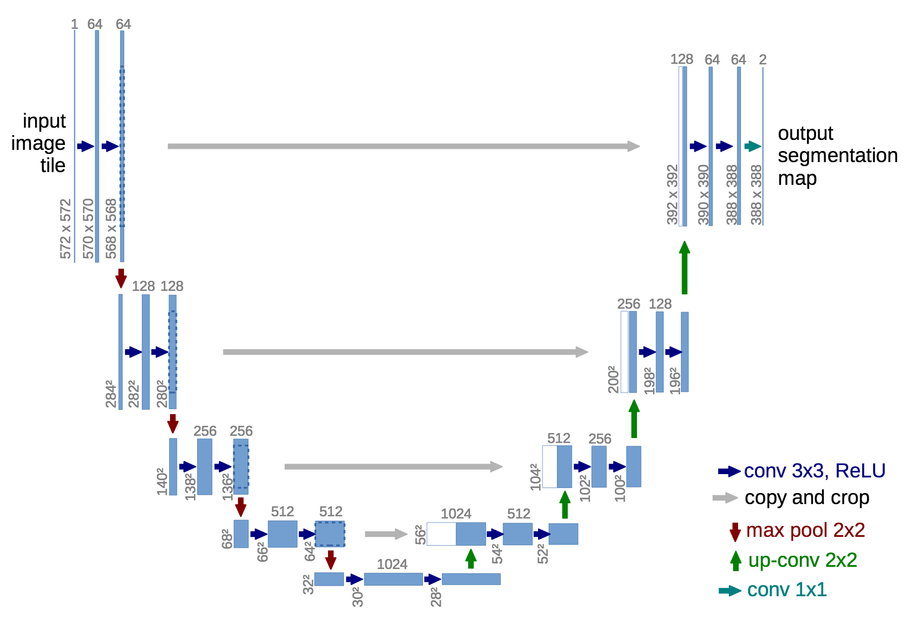
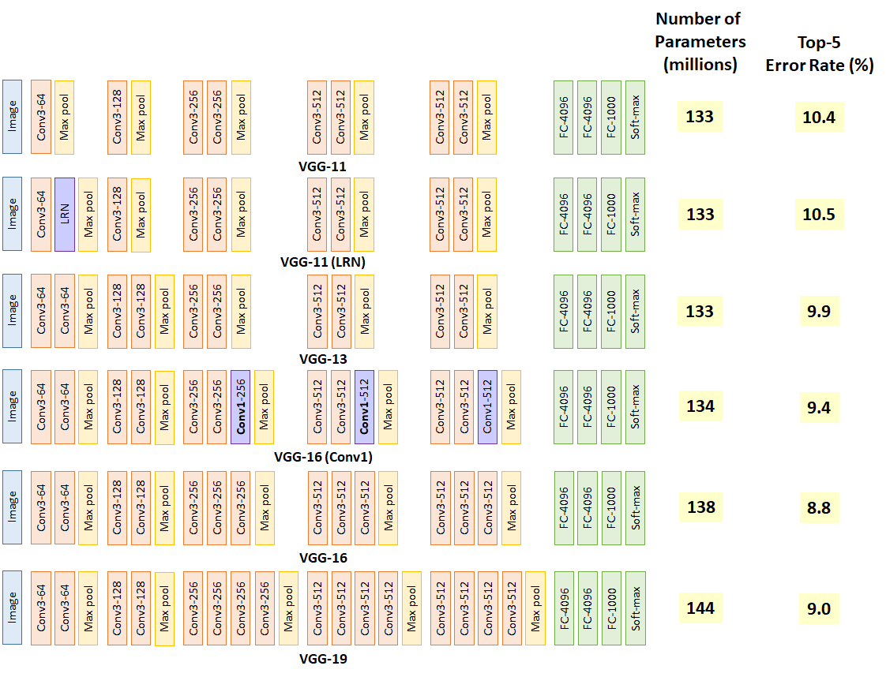
Neurons and layers
Notes:
We typically don’t deal with neurons directly, only layers
Deep learning papers will have diagrams like these, where the number of parameters is huge

Slide 44
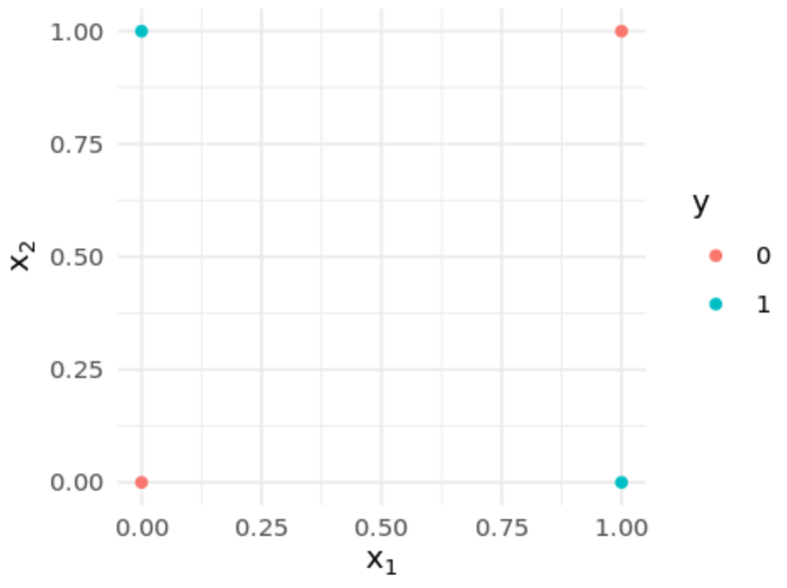
The XOR problem
The XOR problem is a famous problem (1960s) in deep learning.
Early networks only used a single layer, and cannot solve XOR.
By adding a single hidden layer we can implement XOR.

Slide 45



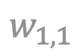



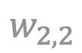



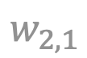

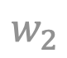
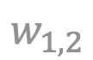


Prediction with a hidden layer
$$b_{1}$$
$$b_{1}$$
$$w_{1,1}$$
$$\overset{m}{\underset{i=1}{∑}}w_{1,i}x_{i}+b_{1}$$
$$x_{1}$$
$$a_{1}$$
$$w_{1}$$
$$w_{1,2}$$
$$\overset{m}{\underset{i=1}{∑}}w_{i}a_{i}$$
$$\overset{̂}{y}$$
$$w_{2,1}$$
$$\overset{m}{\underset{i=1}{∑}}w_{2,i}x_{i}+b_{2}$$
$$w_{2}$$
$$x_{2}$$
$$a_{2}$$
$$w_{2,2}$$
$$b_{2}$$
Notes:
Two neurons in the hidden layer, one in the output layer
For this example and the notebook exercises, we do not have a bias or activation function in the output neuron

Slide 46
Hands-on
Go to https://https://jupyter.lisa.surfsara.nl:8000/
Notebook: 01b-network-from-scratch.ipynb
16:30-17:15

Slide 47
Summary
Deep learning is a subfield of machine learning in which the model learns to represent the data using many levels of concept hierarchies.
Deep learning has greatly improved performance in many tasks involving complex data.
Neural networks are made from connected neurons which combine into layers. The network maps the input x to an output y.
The environment @ https://jupyter.lisa.surfsara.nl:8000/
If you have any questions, post them @ Canvas

